Slide 1
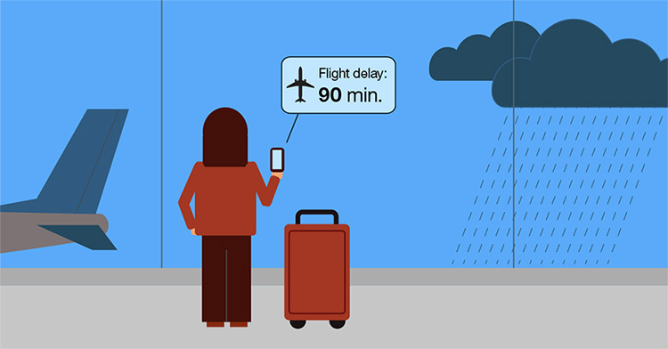

Secrets of Avoiding Flight Delays at NYC
Group 18
October 25, 2019

Slide 2
Research Questions
1. NYC Airports general analysis (definition of delays and airport characteristics how many passengers, destinations bla bla; ) - Sinem
2. Time based analysis of delays (time, day, month, season, outliers based on time)-Mia
3. Comparing airports under the same weather/ event?
4. Comparing airlines for NYC airport, especially for the worst one, compared with the general rank of
(hypothesis testing to see if there are significant difference; pay attention to outliers if interesting)
20XX | 20XX | 20XX | 20XX

Slide 3



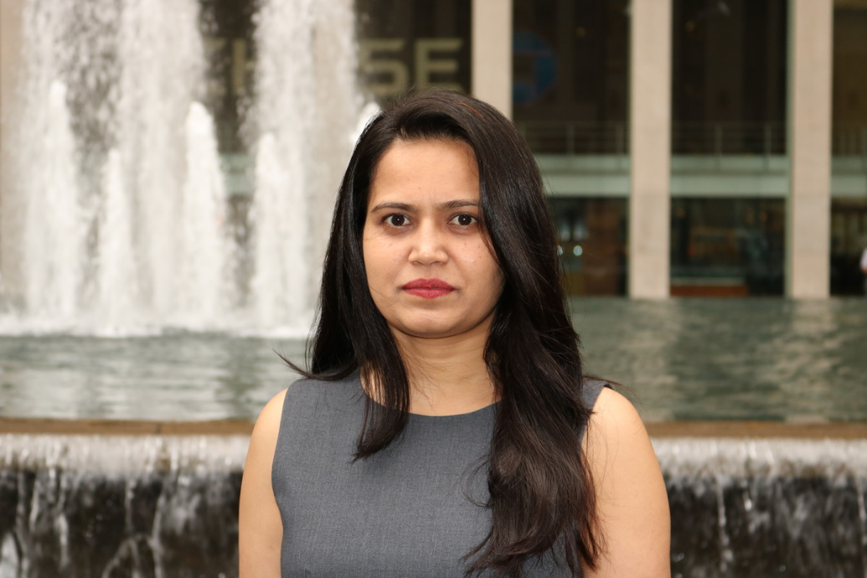
Team Members
Jianing Lu
Mengya (Mia) Hu
Sonal Savaliya
Sinem Uysal
PhD student in Computational Chemistry at New York University
PhD student in Mechanical & Aerospace Engineering at Princeton University
MS Computer Science, Pace University
PhD student at Operations Research and Financial Engineering at Princeton University

Slide 4
Big Picture Analytics of NYC airports
Delay definition
NYC airport qualitative characteristics - passenger number, routes, size , yearly number of flights
Delay comparison - time, frequency, breakdown (explanation of these groups)
Delays among different routes
Sinem

Slide 5
Time based analysis of delays
Time based analysis of delays (time, day, month, season, outliers based on time)
Mia

Slide 6
Weather Type Analysis
Worst weather type that affects airline delays in NYC
Airline delays with weather types per Airport
Weather delays frequency per month
Sonal

Slide 7
Which Airline?
Airline rank in 2017. But which one is the best in New York City?
Compare different airlines in different airport
Compare airline performance on different time
Jianing

Slide 8
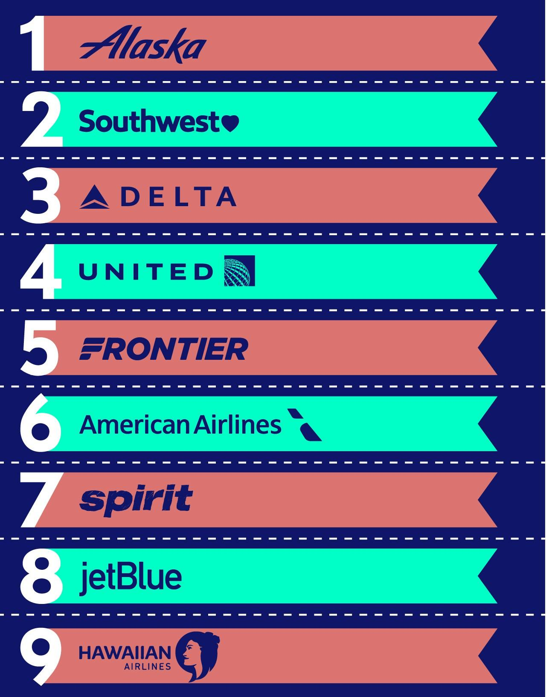
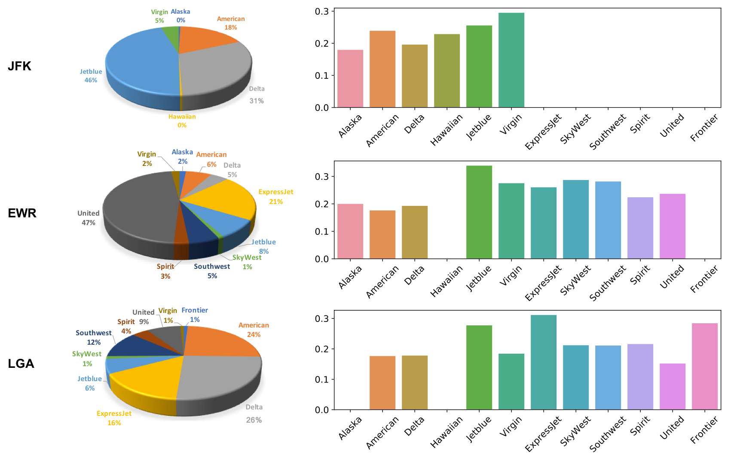
Airline in NYC Airports
Airline Ranking in 2017
Airline Ranking based on Delay Percentage
How about NYC airports?

Slide 9
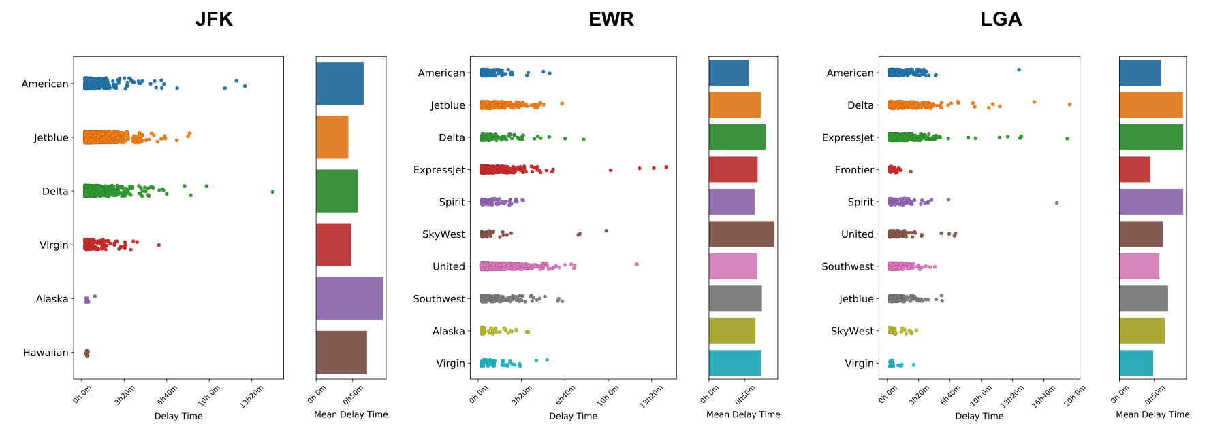
Airline in NYC Airports:

Slide 10
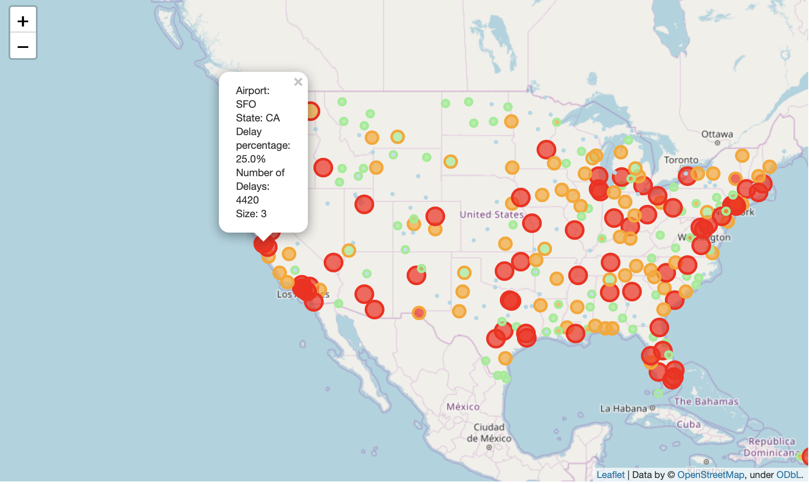

Slide 11
THANK YOU :)

Slide 12
